Slide 1
Microsoft AI Skills Fest

Slide 2
AI in action: Unlock productivity at work
Session Guide for Instructors | English
Notes:
1 min | Opening (Slide 2)
[Opening Scene: Instructor on camera, welcoming participants with an engaging and enthusiastic tone.]
Instructor: Hello and welcome! I’m thrilled to have you here for "AI in Action: Unlock Productivity at Work."
My name is <name>, and I’m a <my role> at Microsoft. I’m here to guide you through this fast-paced, interactive session where you’ll discover practical ways AI can simplify your work, reduce errors, and free up time—so you can focus on what truly matters.
And the best part? You don’t need to be an AI expert to benefit from this!

Slide 3
Welcome to Microsoft AI Skills Fest!
AI in action: Unlock productivity at work
Empower learners to build AI skills and work smarter, not harder
As an instructor, you play a key role in guiding participants through this interactive, 50-minute session designed to help business professionals and leaders unlock AI’s potential in their daily work. This session guide has been created to help you prepare effectively and deliver a smooth, engaging experience.
In this session, you will:
Introduce practical AI applications relevant to their workflows
Facilitate interactive exercises and discussions
Encourage experimentation with AI-powered tools like Microsoft Copilot
Support participants in crafting effective AI prompts to boost productivity
By the end, learners will feel confident, inspired, and ready to integrate AI into their routines. We encourage you to foster a collaborative learning environment by prompting questions, encouraging discussion, and creating a space for open dialogue.
Microsoft AI Skills Fest Business User Content Team
Thank you for your time and expertise in delivering this session!
Your guidance is invaluable in helping learners build AI skills and apply them effectively in their work.

Slide 4
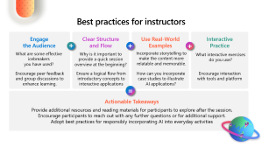
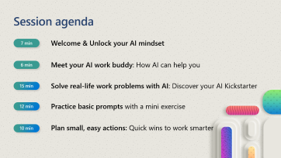
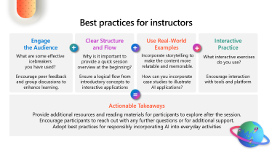
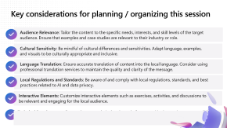
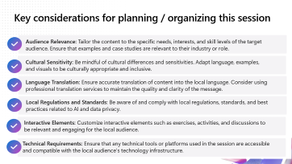
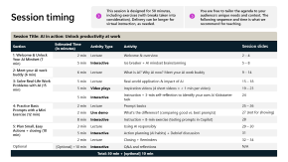
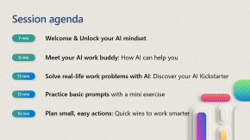
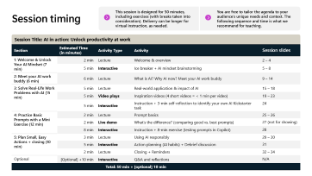
What you can expect
This session guide includes:
1
2
3
Session overview
Get a high-level outline of the session, including its structure, key topics, and planning consideration
Best practices to deliver this session
Discover strategies to deliver an engaging and impactful session, whether in-person or virtual.
Instructor guide
Access practical tools and guidelines to create an engaging learning experience for all participants.

Slide 5
1: Session overview
Dive into the world of generative AI and discover how it can simplify your daily tasks.

Slide 6
Session agenda
7 min
Welcome & Unlock your AI mindset
6 min
Meet your AI work buddy: How AI can help you
15 min
Solve real-life work problems with AI: Discover your AI Kickstarter
12 min
Practice basic prompts with a mini exercise
10 min
Plan small, easy actions: Quick wins to work smarter

Slide 7




Help learners to participate in our GWR challenge
What you need to know about this challenge
1
What’s the GUINESS WORLD RECORDS™ challenge? We’re attempting to set a GUINESS WORLD RECORDS™ for the most participants trained in AI within 24 hours! This record-breaking event runs from April 7th to April 8th, spanning all time zones as part of the Microsoft AI Skills Fest. This initiative is open to everyone looking to enhance their AI skills.
How will participants register for the event? Participants should register at https://aka.ms/AISkillsFest to be counted in this extraordinary world record attempt. (i.e., Session Slide p. 3)
How will participants complete the challenge? To earn their digital GWR badge, participants must: 1) register at the link above, 2) complete this training session, and 3) complete the final step (i.e., knowledge check and attestation) within the challenge period. The final step to claim the badge is introduced at the end of this session (i.e., Session Slide p. 33). Once complete, they will receive a digital badge to their registered email address.
What if I’m delivering this session past April 8th? Participants won’t be able to join the official record attempt, but they can still continue their AI learning journey! After the April 8th kickoff, they are encouraged to join engaging follow-up sessions and challenges over the next 50 days to deepen their AI skills.
GUINESS WORLD RECORDS™
2
3
4

Slide 8


Key considerations for planning / organizing this session
Audience Relevance: Tailor the content to the specific needs, interests, and skill levels of the target audience. Ensure that examples and case studies are relevant to their industry or role.
Cultural Sensitivity: Be mindful of cultural differences and sensitivities. Adapt language, examples, and visuals to be culturally appropriate and inclusive.
Language Translation: Ensure accurate translation of content into the local language. Consider using professional translation services to maintain the quality and clarity of the message.
Local Regulations and Standards: Be aware of and comply with local regulations, standards, and best practices related to AI and data privacy.
Interactive Elements: Customize interactive elements such as exercises, activities, and discussions to be relevant and engaging for the local audience.
Technical Requirements: Ensure that any technical tools or platforms used in the session are accessible and compatible with the local audience's technology infrastructure.

Slide 9
2: Best practices to deliver this session
Effective methods for presenting an engaging, informative, and impactful session in person or virtually

Slide 10

Best practices for instructors
Engage the Audience
Clear Structure and Flow
Use Real-World Examples
Interactive Practice
+
+
+
What are some effective icebreakers you have used?
Why is it important to provide a quick session overview at the beginning?
Incorporate storytelling to make the content more relatable and memorable.
What interactive exercises do you use?
Encourage peer feedback and group discussions to enhance learning.
Ensure a logical flow from introductory concepts to interactive applications
How can you incorporate case studies to illustrate AI applications?
Encourage interaction with tools and platform
=
Actionable Takeaways
Provide additional resources and reading materials for participants to explore after the session.
Encourage participants to reach out with any further questions or for additional support.
Adopt best practices for responsibly incorporating AI into everyday activities

Slide 11

1: Virtual delivery: best practices (1 of 1)
Creating Engaging Virtual Environment
Ways to Engage Participants
Set expectations upfront – Provide an overview of the session structure, participation guidelines, and how learners can engage.
Session recording (if applicable): Confirm whether the session will be recorded and inform participants.
Encourage video participation – If possible, ask participants to turn on their cameras to foster a more interactive and connected learning experience.
Use clear and concise communication – Speak at a steady pace, pause for questions, and check for understanding frequently
Start with an interactive icebreaker – Use the chat, polls, or quick word cloud activities to encourage participation
Leverage breakout rooms – If the platform allows, use small group discussions for deeper engagement and collaboration
Use chat and reactions – Encourage participants to share insights, ask questions, and react using chat functions and emojis to create an interactive atmosphere
Assign a co-host or moderator – Have a support person manage the chat, technical issues, or breakout room discussions if needed.
Notes:
2 min | [Slide: For in-person delivery] (Slide 10)

Slide 12
1: Virtual delivery: best practices (2 of 2)
Using Technology Effectively
Ensuring a Smooth Virtual Experience
If available, integrate interactive tools – Use features like live polls, whiteboards, or quizzes to keep participants engaged and gather real-time feedback
Share your screen strategically – Minimize long slideshows; instead, switch between visuals, live demos, and discussions
Optimize for accessibility – Enable captions if possible and ensure instructions are clear for participants using different devices.
Test your tech beforehand – Check your microphone, camera, screen-sharing capabilities, and any interactive tools you'll be using
Have a backup plan – Be prepared with alternative ways to deliver content in case of technical difficulties
Build in moments for reflection and Q&A – Allow time for participants to process information, ask questions, and apply what they’ve learned.
Follow-up resources: Provide a summary of key takeaways, links to additional resources, or next steps after the session.
Notes:
2 min | [Slide: For in-person delivery] (Slide 10)

Slide 13
2: In-person delivery: best practices (1/2)
Ideal Logistical Requirements
Ways to Engage Participants
Classroom Settings
Ensure tables are arranged to facilitate interaction, such as in a U-shape tables or team tables.
Provide necessary materials like notepads, pens, and any specific tools required for the session.
Ensure comfortable seating and adequate space for each participant.
Instructor-to-Participant Ratio
Aim for a ratio of 1 instructor to every 10-15 participants to ensure effective engagement and personalized attention.
For larger cohorts, consider a team-based setup with designated team leaders to help facilitate discussions and maintain engagement
Consider having additional support staff or assistants to help with logistics and participant queries.
Interactive Activities
Consider sharing your own stories and examples to create a safe space for open dialogue.
Use icebreaker activities to build rapport and ease participants into the session.
Incorporate group discussions and collaborative exercises to encourage active participation.
Use of Technology
If available, use interactive tools like polls and quizzes to engage participants and gather instant feedback (e.g., feelings about AI, identifying time-consuming tasks AI could help with).
When using AI to create or tailor content, verify and refine outputs to ensure clarity, fairness, and alignment with session goals.
Notes:
2 min | [Slide: For in-person delivery] (Slide 10)

Slide 14
2: In-person delivery: best practices (2/2)
Showcasing Demos
FAQ
Live Demonstrations
Ensure all equipment and materials for live demos are prepared and tested beforehand.
Clearly explain each step of the demo and its relevance to the participants.
Interactive, Guided Practice
Allow participants to try out the demo themselves with guidance from the instructor.
Provide immediate feedback and support to participants during the interactive practice.
Preparation
Prepare a list of frequently asked questions and their answers related to the session's content.
Accessibility
Make the FAQs easily accessible to participants, either in printed form or digitally.
Q&A Sessions
Dedicated Time: Allocate dedicated times during the session for Q&A to address any participant queries.
Encourage participants to ask questions and engage in discussions.
Notes:
2 min | [Slide: For in-person delivery] (Slide 10)

Slide 15
3: Instructor guide
Practical tools and resources for instructors

Slide 16
At-a-glance session overview
Est. Time | Section: Key Topics & Activities | Notes for Planning
7 min | 1: Welcome & Unlock Your AI Mindset Introduction & Housekeeping: Register for GWR challenge, open Copilot, and get ready for hands-on activities Icebreaker—share your location and an adjective about AI in the chat Reframing question to shift our mindset: What would you do with two extra hours each week? Session Goal: Identify one small way AI can enhance your work today (“AI Kickstarter”) | For in-person delivery, icebreaker can be adapted to writing adjectives on sticky notes for a flip chart activity.
6 min | 2: Meet Your AI Work Buddy: How AI Can Help You What is AI & Generative AI? Simple explanation and core benefits Why AI Matters Now: Work is getting faster, and AI helps us keep up Common AI use cases across functions and industries: From drafting emails to creating AI-powered customer support
15 min | 3: Solve Real-Life Work Problems with AI – Discover your AI Kickstarter task Case examples: How businesses are transforming their business with AI + impact stories Finastra example: using AI to improve efficiency in marketing workflows Exploring AI opportunities for your own role: Common use cases and real examples Video Inspiration: Short clips from Microsoft colleagues using AI in their roles Self-Reflection Exercise (3 min): Identify your own “AI Kickstarter” task | Self-reflection can be adapted to pair activities based on cohort size
12 min | 4: Practice Basic Prompts with a Mini Exercise Prompting Basics: How to structure effective AI prompts Live Demo: Comparing weak vs. strong prompts in Copilot Mini Exercise (7 min): Draft and test your own AI prompt for your AI Kickstarter task; Share key learnings and insights with peers. | Mini-exercise can be converted into small group breakouts (5-6 participants) if needed
10 min | 5: Plan Small, Easy Actions: Quick Wins to Work Smarter Using AI Responsibly: Fairness, privacy, accuracy, and bias awareness Building AI Habits: Identify an AI-powered task to try daily Tips: Set reminders, choose an accountability buddy, and integrate AI into your workflow Celebration & Badge: Claim your Guinness World Record AI Skills Fest badge! | CTA for GWR badge post 4/7 – 4/8 can be converted into a 50-Day Challenge
Learning Objectives
By the end of this course, learners will be able to:
Recognize AI’s potential and identify exciting opportunities to work smarter
Explain what AI is and share simple, real-world use cases
Identify and apply AI to streamline tasks and minimize errors
Draft basic prompts and plan small, responsible actions to integrate AI into their work
Learning Materials & Equipment
Session slides
Instructors: 1 Laptop + screen to show slides
Learners: Mobile phone or laptop to participate in the mini exercise

Slide 17

Session timing
This session is designed for 50 minutes, including exercises (with breaks taken into consideration). Delivery can be longer for virtual instruction, as needed.
You are free to tailor the agenda to your audience’s unique needs and context. The following sequence and time is what we recommend for teaching.
Session Title: AI in action: Unlock productivity at work
Section | Estimated Time (in minutes) | Activity Type | Activity | Session slides
1: Welcome & Unlock Your AI Mindset (7 min) | 2 min | Lecture | Welcome & overview | 2 – 4
 | 5 min | Interactive | Ice breaker + AI mindset brainstorming | 5 – 8
2: Meet your AI work buddy (6 min) | 6 min | Lecture | What is AI? Why AI now? Meet your AI work buddy | 9 – 14
3: Solve Real-Life Work Problems with AI (15 min) | 5 min | Lecture | Real-world application & impact of AI | 15 – 18
 | 5 min | Video plays | Inspiration videos (4 short videos = < 1 min per video) | 19 – 23
 | 5 min | Interactive | Instruction + 3-min self-reflection to identify your own AI Kickstarter task | 24
4: Practice Basic Prompts with a Mini Exercise (12 min) | 2 min | Lecture | Prompt basics | 25 – 26
 | 2 min | Live demo | What’s the difference? (comparing good vs. best prompts) | 27 (not for showing)
 | 8 min | Interactive | Instruction + 8-min exercise (testing prompts in Copilot) | 28
5: Plan Small, Easy Actions + closing (10 min) | 3 min | Lecture | Using AI responsibly | 29 – 30
 | 5 min | Interactive | Action planning (AI habits) + Debrief discussion | 31
 | 2 min | Lecture | Closing + Reminders | 32 – 34
Optional | [Optional] +10 min | Interactive | Q&A and reflections | N/A
Total: 50 min + [optional] 10 min

Slide 18
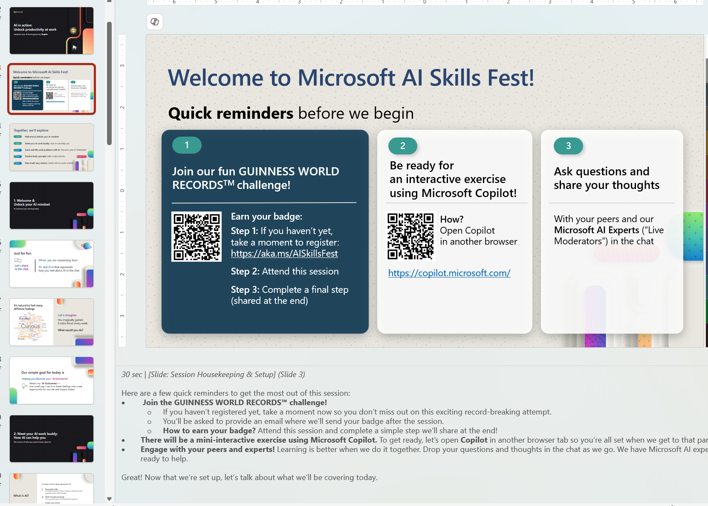
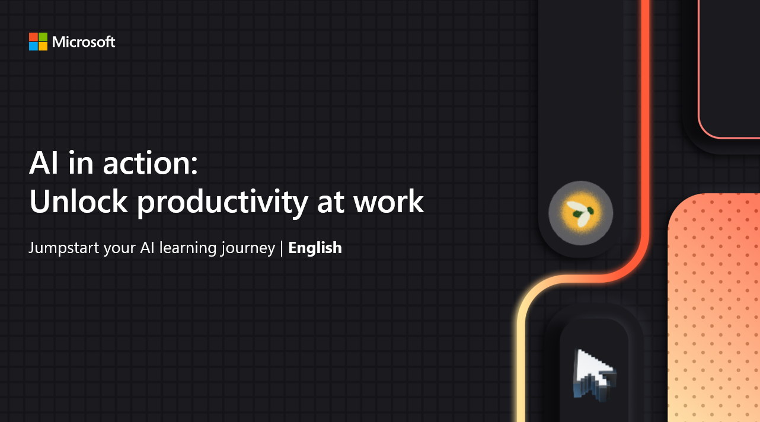
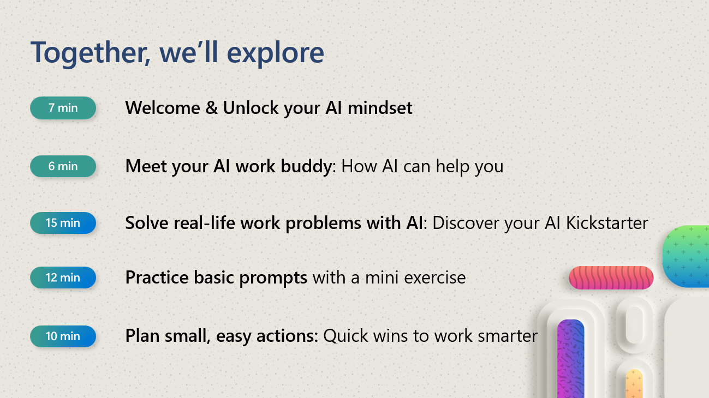

Instructions to use our session slides
1: Review the session slides in advance
To ensure a smooth delivery, familiarize yourself with the session slides ahead of time. The content is structured around these slides, so reviewing them will help you lead an engaging and well-paced session.
2: Consider following the suggested talking points and timing
Each slide includes recommended talking points and estimated speaking time to help you stay on track. You can find these details in the slide notes.

Slide 19
For your note: our content reference
Module
Unit
This session content has been moderately adapted from a Microsoft Learn module to better align with the needs of business professionals and leaders.
Use the original module as a reference source for deeper insights and additional learning.
The table on this page provides a breakdown of each module, including covered units and a direct link to the corresponding content in Microsoft Learn.
Module 1: Use AI for everyday tasks
Use AI for everyday tasks - Training | Microsoft Learn
Unit 1: Introduction
Unit 2: What is AI?
Unit 3: Explore prompting
Unit 4: Discover ways to use AI in your personal life
Unit 5: Discover ways to use AI at work
Unit 6: Exercise: Personalize and refine prompts
Unit 7: Knowledge check
Unit 8: Summary

